Slide 2
What is LANDED?
Working in Lanarkshire, we provide drug, alcohol, sexual health, cannabis and tobacco information to young people using informal & peer education approaches.
Our services: Stalls, Workshops, Staff Training, Volunteering Opportunities (16-22).
Connect with us…
/LandedPeerEd
@LANDEDPeerEd
www.landed.info

Slide 3
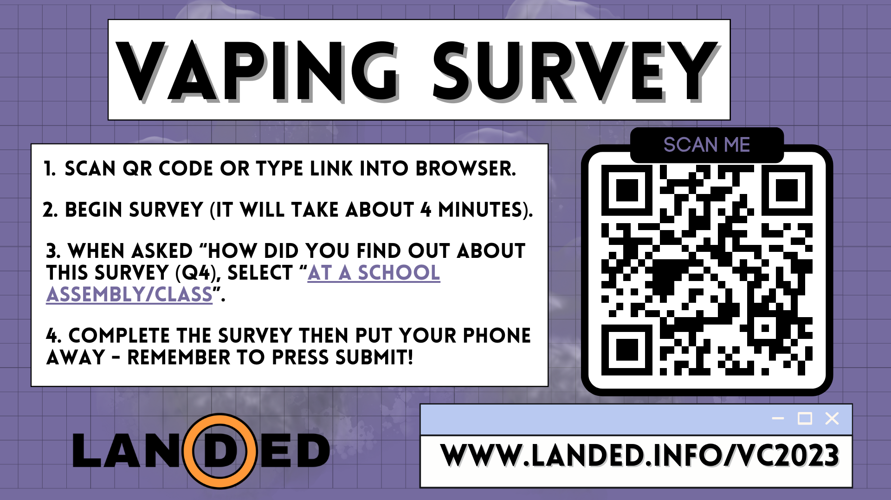

Slide 4
VAPING INFORMATION

Slide 5
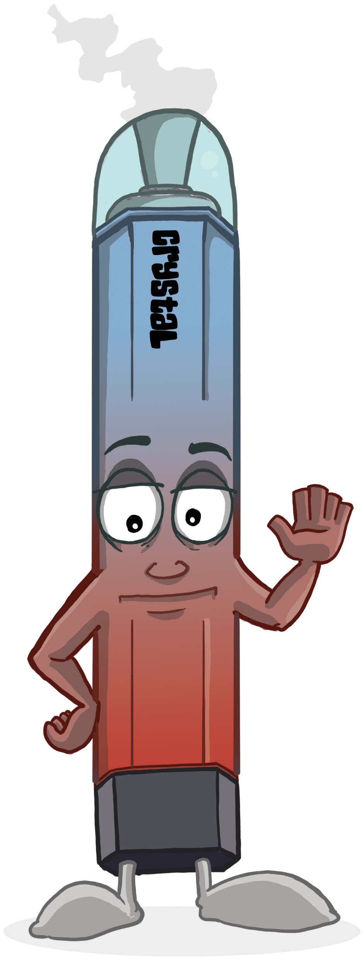
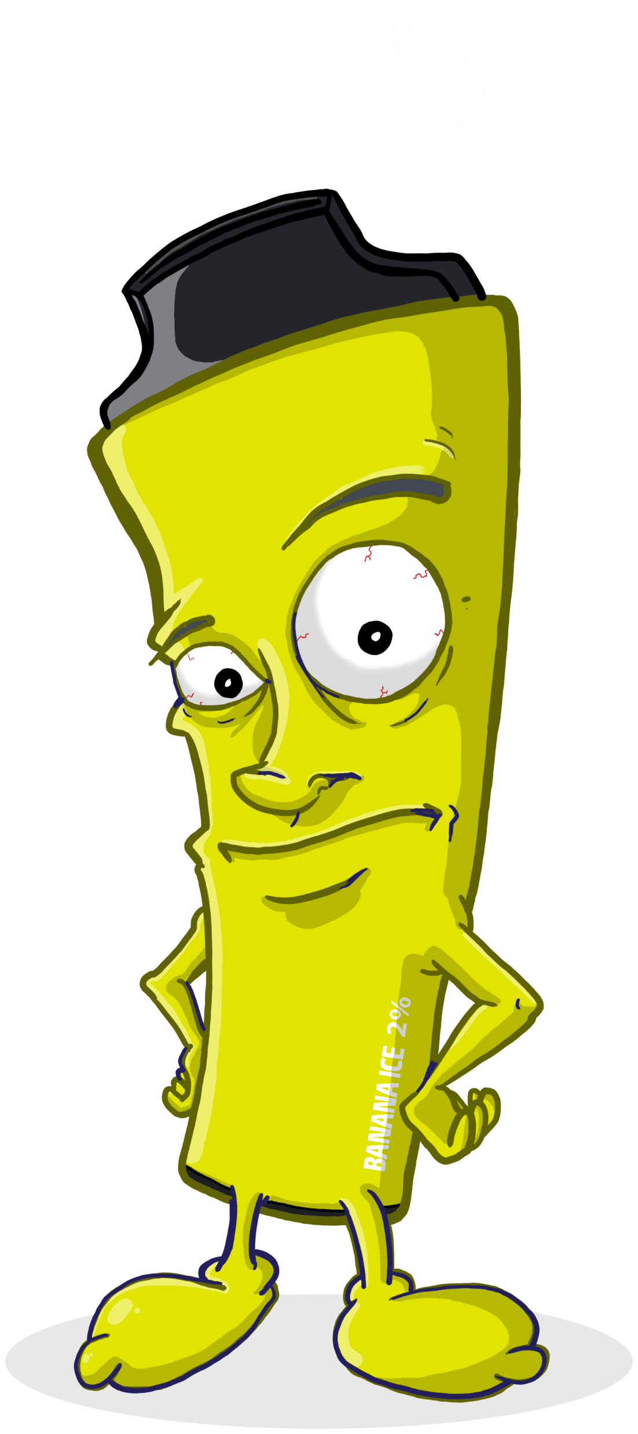
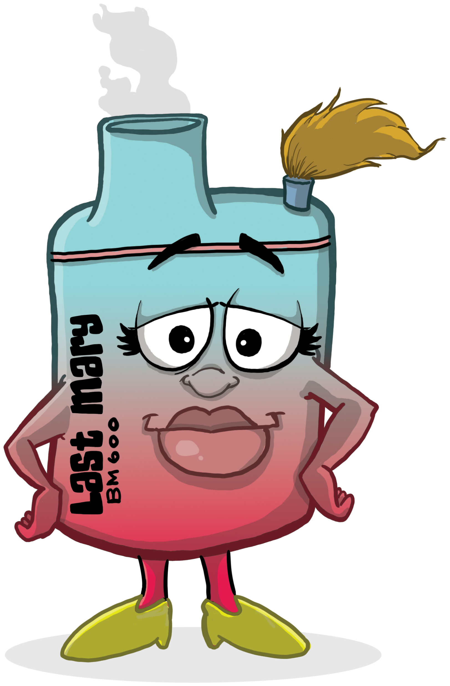
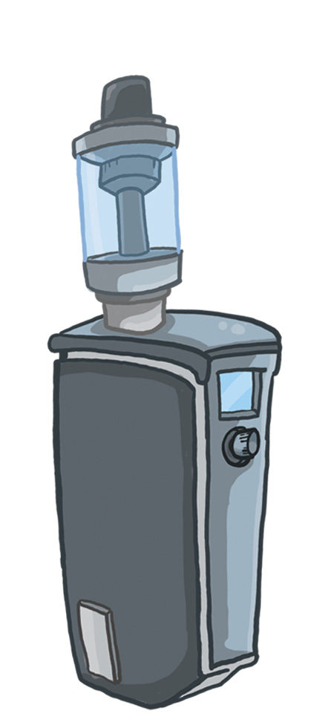
What is a vape?
E-cigs, vapes or vaporisers are electronic cigarettes.
They aim to resemble cigarettes but they do not burn tobacco.
Vapes come in many different shapes, sizes and colours.
The most popular type in 2023 are disposables or single-use vapes.

Slide 6
Source: ElfBar
Source: https://twitter.com/markmiodownik/status/1574313785569034241

Slide 7
Why do people vape?
So far, our survey has found that the TOP THREE reasons people vape are:
I am addicted
It relaxes me
I like the flavours and taste

Slide 9
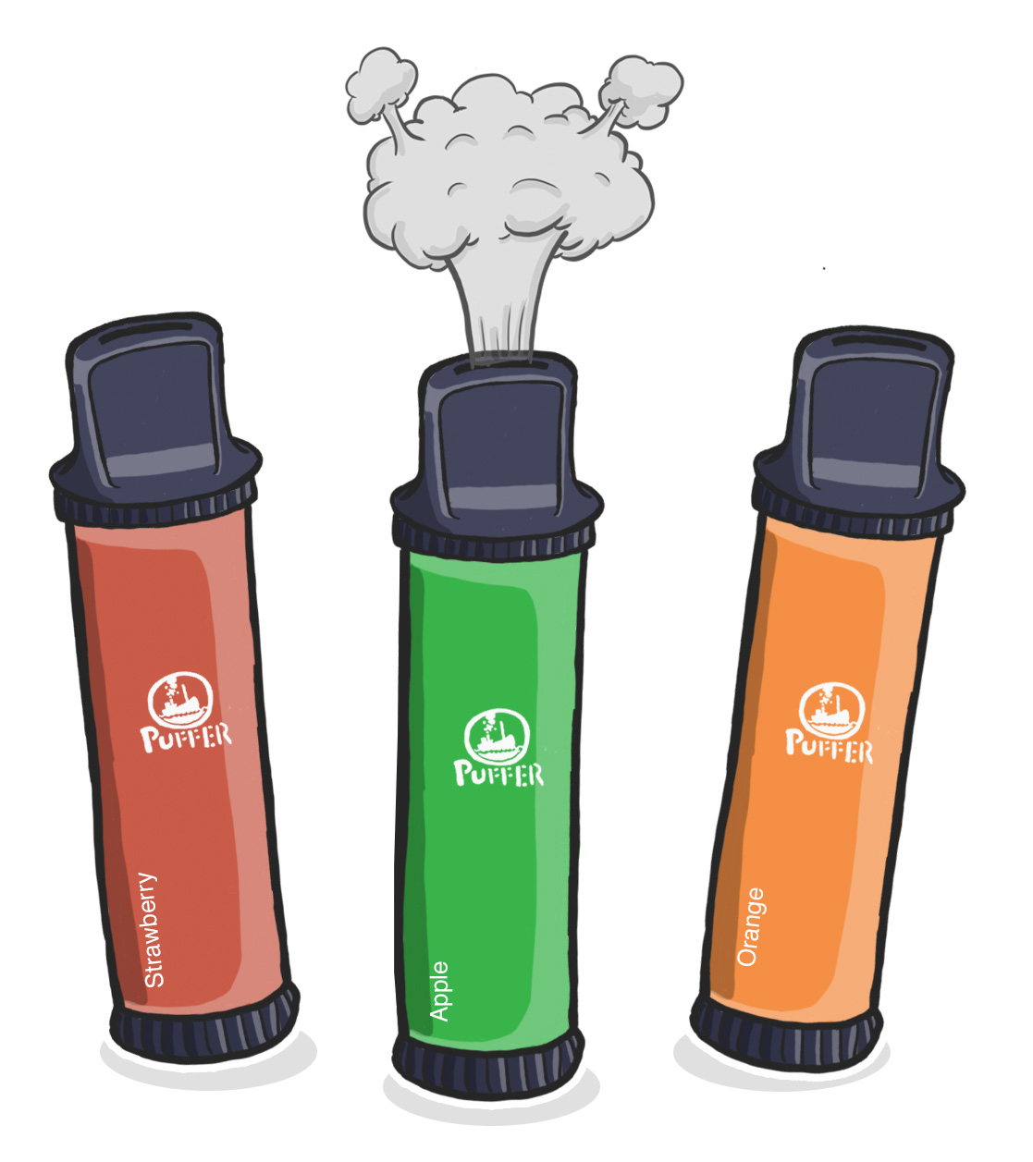
What’s in a vape?
=

Slide 10
The long-term effects of vaping are currently UNKNOWN.
You are taking an unknown
risk by vaping.

Slide 11
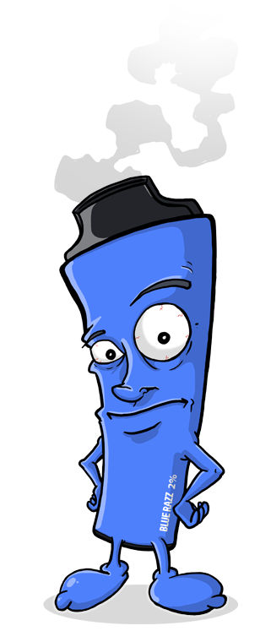
The Latest Vaping Information
Current research suggests that vapes are less harmful when compared to smoking tobacco.
However, vapes should not be used by non-smokers or young people.
Developing a nicotine addiction, or habit of vaping through the use of vapes from a young age might lead to young people taking up smoking in the future.
Using an vape without fully stopping smoking does not provide health benefits.
Recent studies suggest that e-cigarettes are health-harming, specifically, they can negatively impact heart, oral and lung health, and raise your blood pressure.
Disposable vape bars can contain over 20 cigarettes worth of nicotine.

Slide 12
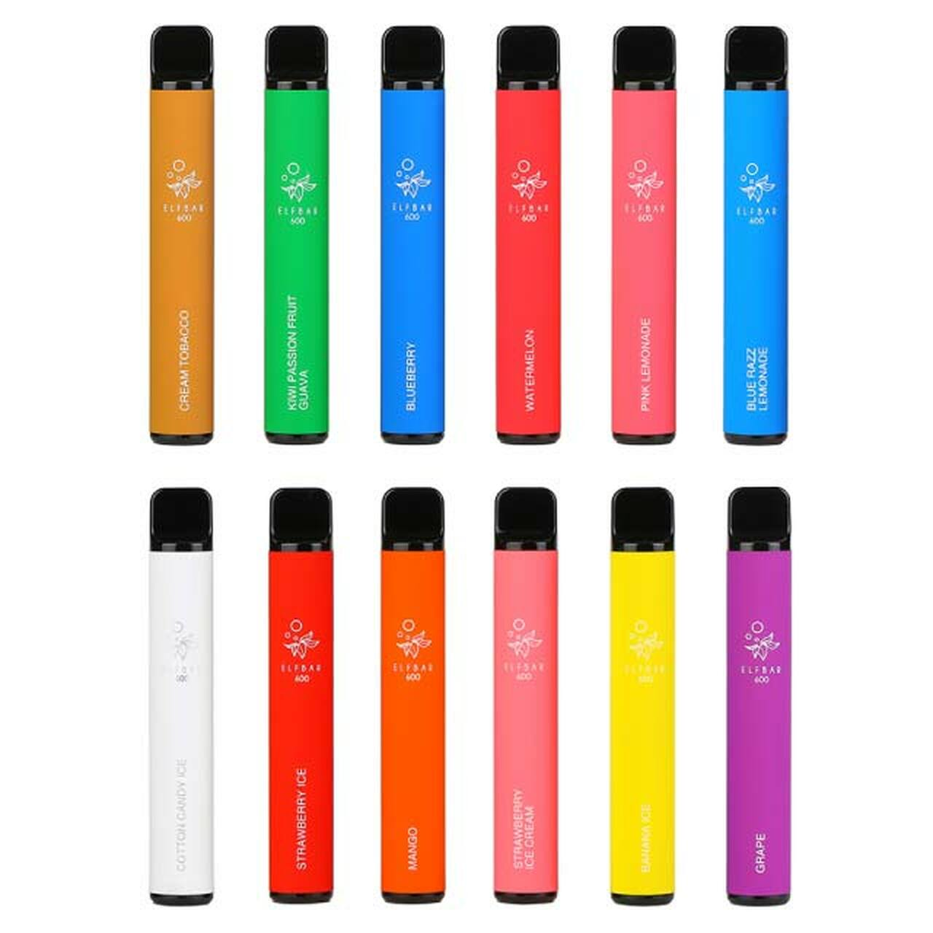
Vapes & The Environment
Vapes are classed as waste electrical and electronic equipment (WEEE). Meaning, they should be disposed of at a recycling center – not in general waste.
It’s estimated that over 7.7 MILLION disposable vapes are sold in the UK PER WEEK!
Around 5 MILLION of these vapes are thrown away instead of recycled (that’s 8 a second).
Incorrect disposal can result in a release of plastic, electronical and hazardous chemical waste.
We have a responsibility to ensure these devices are disposed of correctly.

Slide 13
Source: ElfBar
Source: https://twitter.com/markmiodownik/status/1574313785569034241

Slide 14
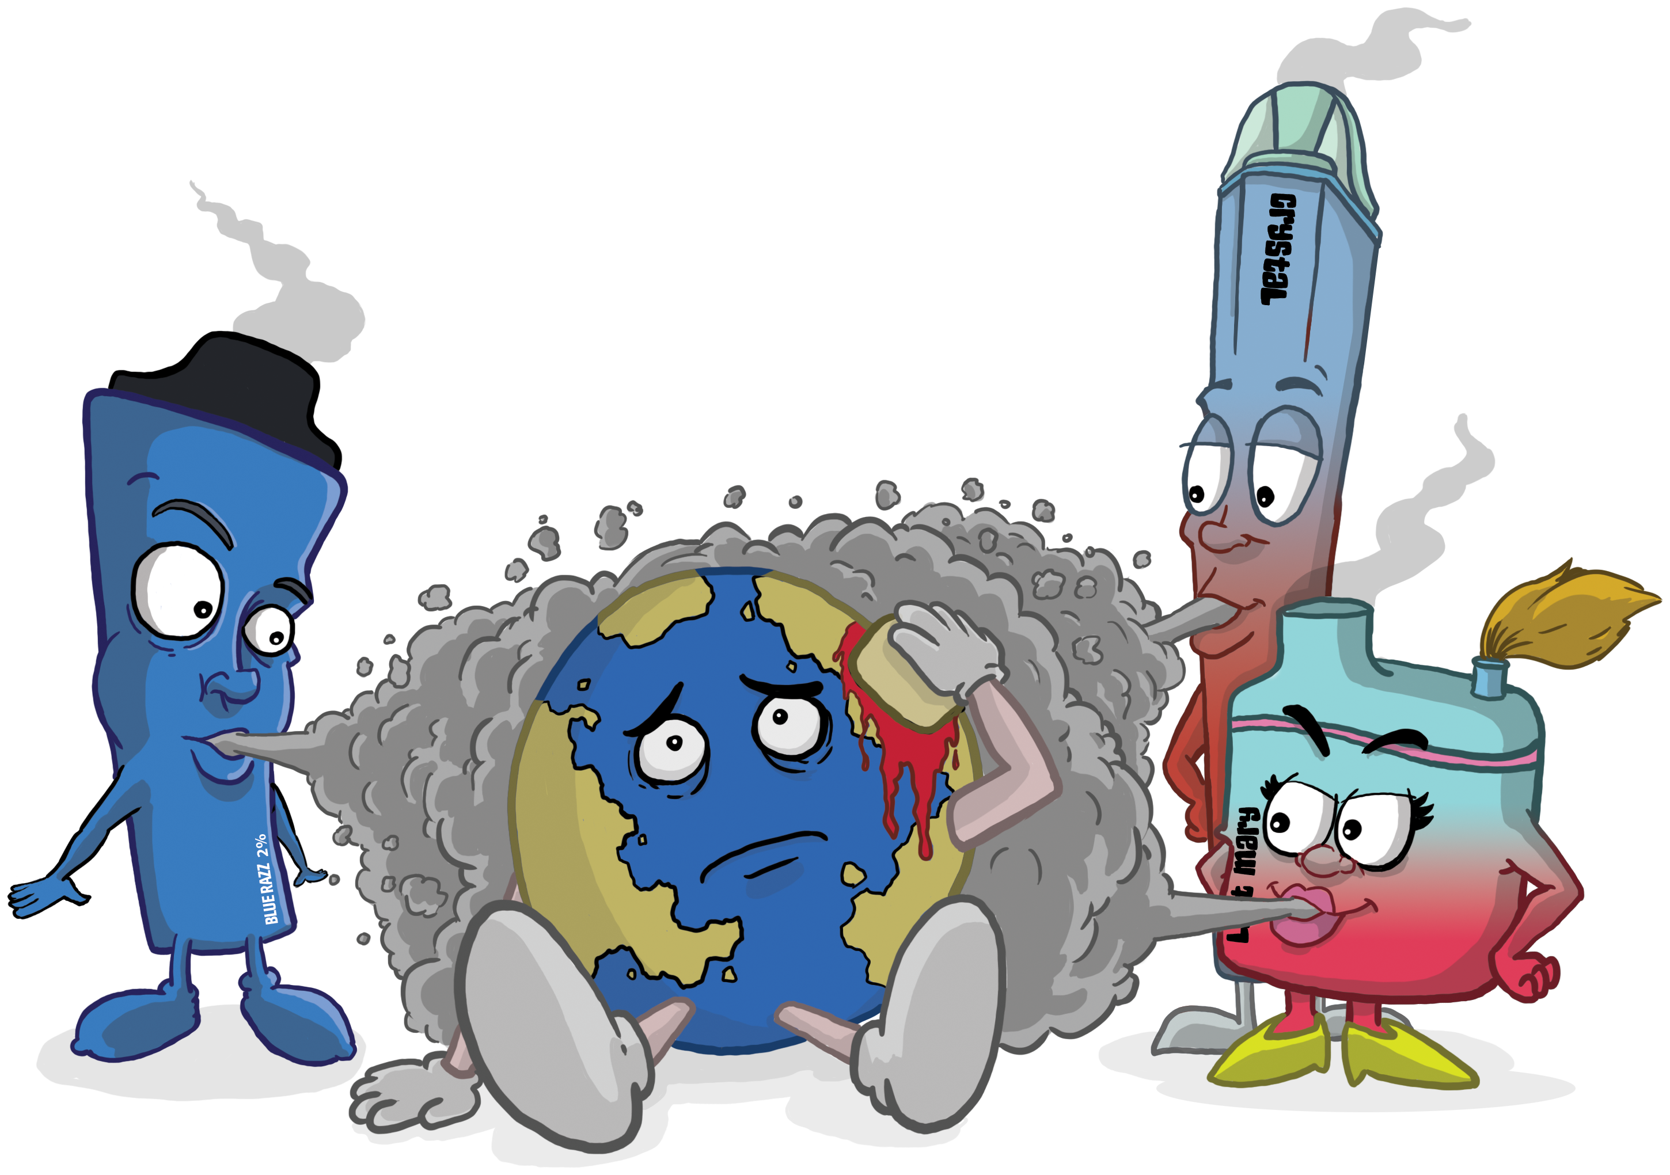
Single-use vapes could take around ONE THOUSAND years to decompose in landfill.
Do not throw them away.

Slide 15
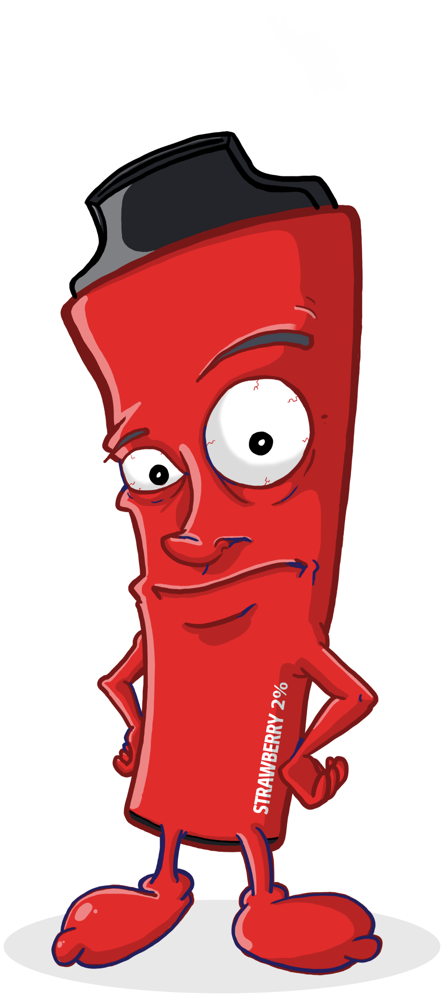
So, how do I recycle my vape?
Do not throw them away.
Recycle the cardboard packaging in blue bin
Put stickers, packets and rubber stoppers in general waste
Put used vape in a vape recycle bin

Slide 16
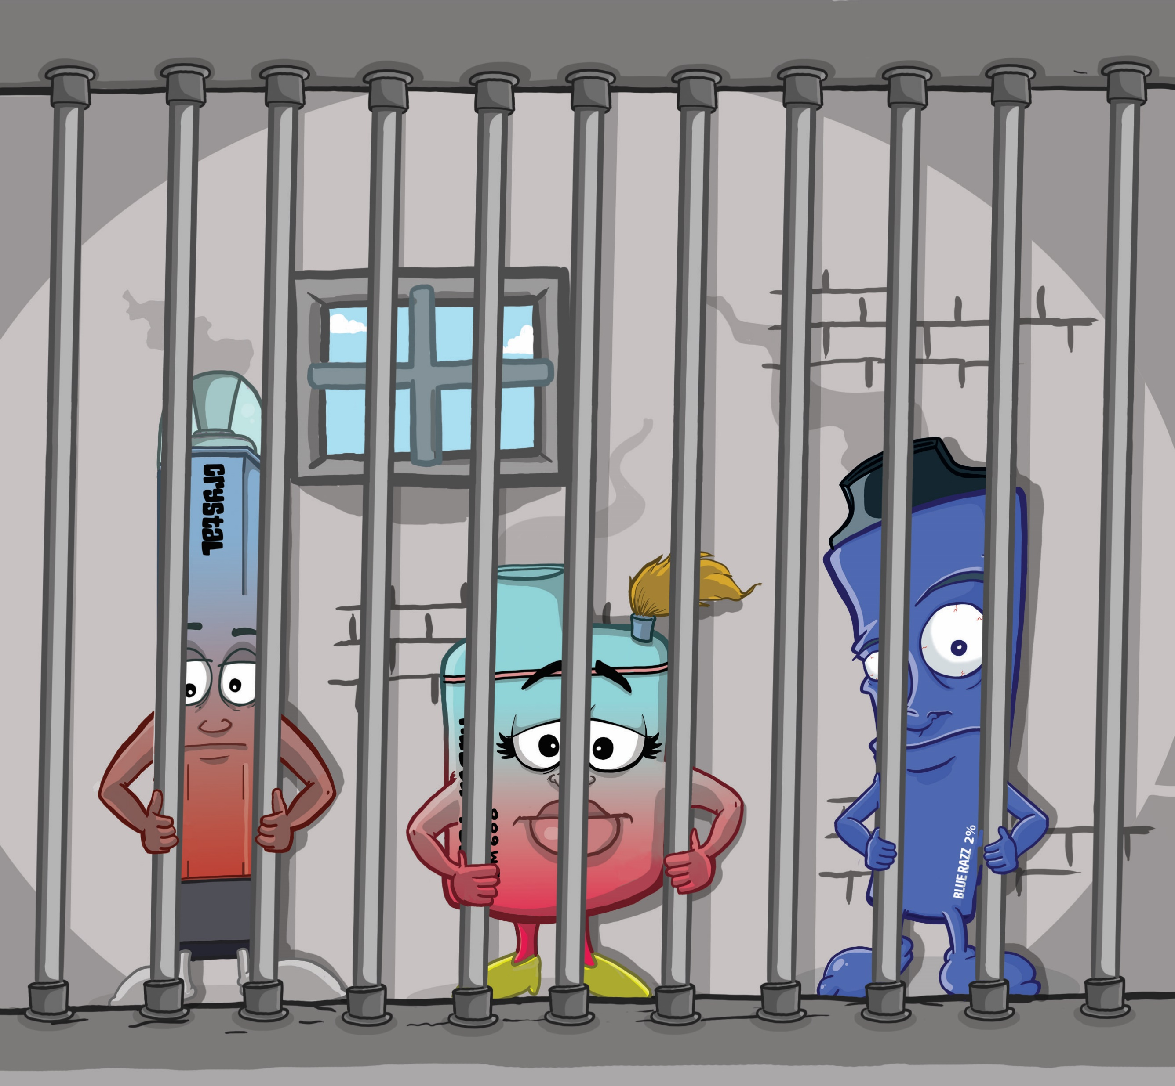
Vaping & The Law
It is ILLEGAL to be sold a vape under the age of 18.
It is ILLEGAL for someone over the age of 18 to buy you a vape.
These laws are in place in an attempt to protect young people in Scotland from becoming addicted to nicotine.

Slide 17
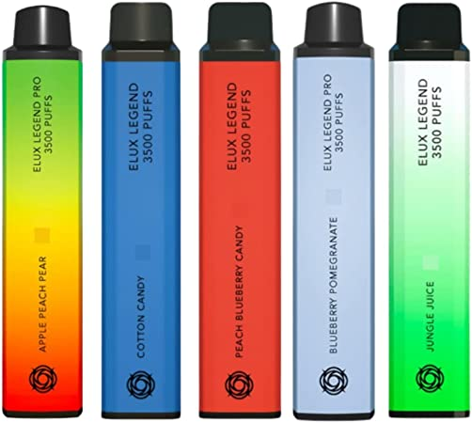
Illegal/Elicit Vaping Products
Vaping products can only be sold in the UK if they meet the following criteria:
E-cigarette refillable tanks bigger than 2ml are banned
E-liquid (with nicotine) cannot be sold in quantities bigger than 10ml
The strength of nicotine must not exceed 20mg/ml
E-liquid packaging must be tamper-evident and child-proof
Some additives, flavourings and ALL colourings are banned
This means vapes advertised with:
More than 600-800 puffs are illegal
More than 20mg/ml or 2% nicotine are illegal
ILLEGAL VAPES ARE KNOWN TO BE MORE HARMFUL.

Slide 18
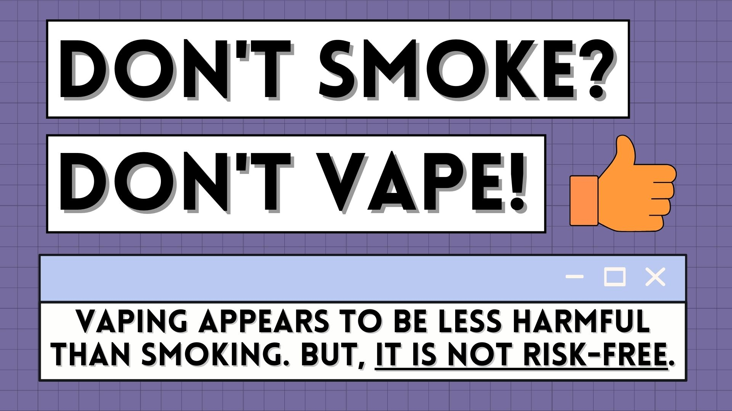

Slide 20
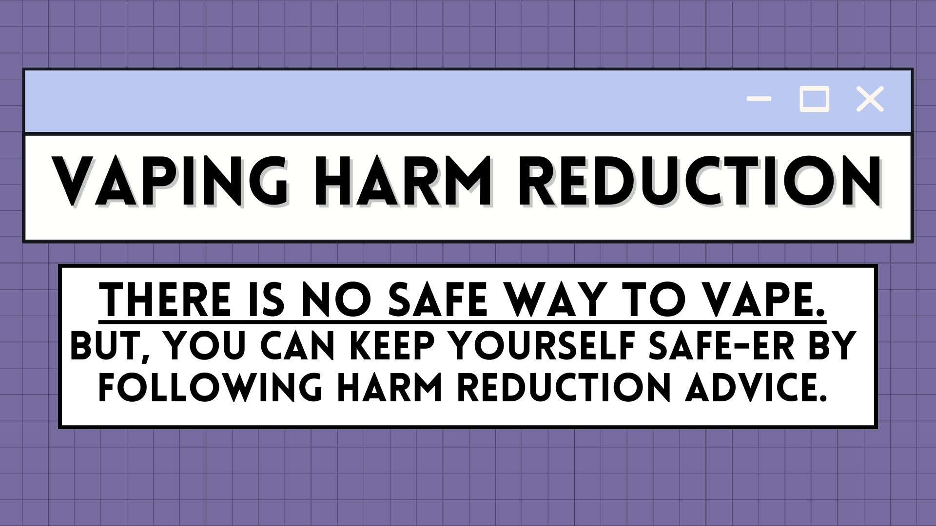

Slide 22
SMOKING INFORMATION

Slide 23
Why should we care about smoking?
Smoking is the leading cause of preventable death in the world.
Tobacco kills more than 7 million people each year.
More than 6 million of those deaths are the result of direct tobacco use while around 890 000 are the result of non-smokers being exposed to second-hand smoke.
The World Health Organisation (WHO)
In Scotland there are approx. 10,000 smoking-related deaths annually.
Alcohol-related deaths - 1,254 Drug-related deaths – 1,330
Notes:
Approximately £1.1 billion annually.
(£271m in healthcare costs, £692m in productivity losses due to active smoking, £60m in productivity losses due to passive smoking, £34m in clearing smoking-related litter, £12m in fires caused by smoking in commercial properties)

Slide 24
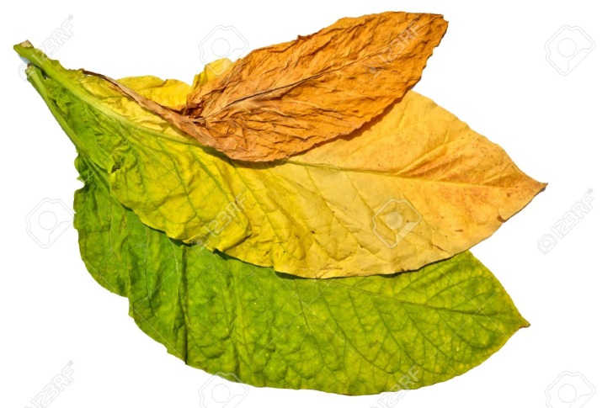
What is Tobacco?
Tobacco is a product made from the leaves of a tobacco plant by curing them.
(Curing is the drying and colour changing process tobacco has to go through before it can be consumed)

Slide 25
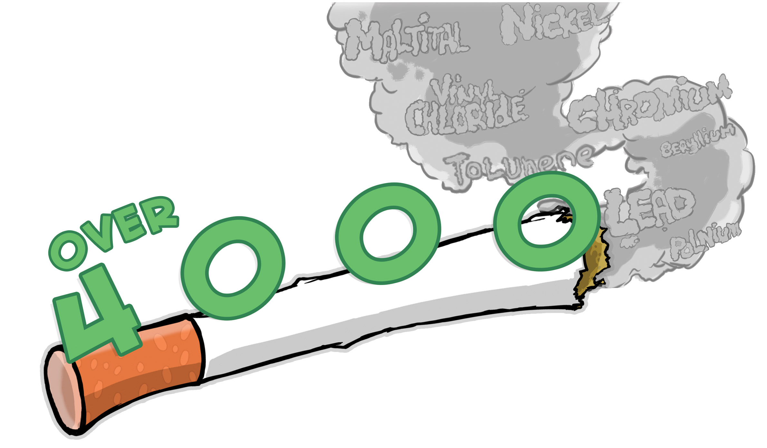
Chemicals in tobacco…
Plus thousands more…

Slide 26
Chemicals in tobacco… continued
Acetanisole,
Acetic Acid,
Acetoin,
Acetophenone,
6-Acetoxydihydrotheaspirane,
2-Acetyl-3- Ethylpyrazine,
2-Acetyl-5-Methylfuran,
Acetylpyrazine,
2-Acetylpyridine,
3-Acetylpyridine,
2-Acetylthiazole,
Aconitic Acid,
dl-Alanine,
Alfalfa Extract,
Allspice Extract,
Oleoresin,
And Oil,
Allyl Hexanoate,
Allyl Ionone,
Almond Bitter Oil,
Ambergris Tincture,
Ammonia,
Ammonium Bicarbonate,
Ammonium Hydroxide,
Ammonium Phosphate Dibasic,
Ammonium Sulfide,
Amyl Alcohol,
Amyl Butyrate,
Amyl Formate,
Amyl Octanoate,
alpha-Amylcinnamaldehyde,
Amyris Oil,
trans-Anethole,
Angelica Root Extract, Oil and Seed Oil,
Anise,
Anise Star, Extract and Oils,
Anisyl Acetate,
Anisyl Alcohol,
Anisyl Formate,
Anisyl Phenylacetate,
Apple Juice Concentrate, Extract, and Skins,
Apricot Extract and Juice Concentrate,
1-Arginine,
Asafetida Fluid Extract And Oil,
Ascorbic Acid,
1-Asparagine Monohydrate,
1-Aspartic Acid,
Balsam Peru and Oil,
Basil Oil,
Bay Leaf, Oil and Sweet Oil,
Beeswax White,
Beet Juice Concentrate,
Benzaldehyde,
Benzaldehyde Glyceryl Acetal,
Benzoic Acid, Benzoin,
Benzoin Resin,
Benzophenone,
Benzyl Alcohol,
Benzyl Benzoate,
Benzyl Butyrate,
Benzyl Cinnamate,
Benzyl Propionate,
Benzyl Salicylate,
Bergamot Oil,
Bisabolene,
Anisyl Phenylacetate,
Black Currant Buds Absolute,
Borneol,
Bornyl Acetate,
Buchu Leaf Oil,
1,3-Butanediol,
2,3-Butanedione,
1-Butanol,
2-Butanone,
4(2-Butenylidene)-3,5,5-Trimethyl-2-Cyclohexen-1-One,
Butter, Butter Esters, and Butter Oil,
Butyl Acetate,
Butyl Butyrate,
Butyl Butyryl Lactate,
Butyl Isovalerate,
Butyl Phenylacetate,
Butyl Undecylenate,
3-Butylidenephthalide,
Butyric Acid,
Cadinene,
Caffeine,
Calcium Carbonate,
Camphene,
Cananga Oil,
Capsicum Oleoresin
Caramel Color,
Caraway Oil,
Carbon Dioxide,
Cardamom Oleoresin, Extract, Seed Oil, and Powder,
Carob Bean and Extract,
beta-Carotene,
Carrot Oil,
Carvacrol,
4-Carvomenthenol,
1-Carvone,
beta-Caryophyllene,
beta-Caryophyllene Oxide,
Cascarilla Oil and Bark Extract,
Cassia Bark Oil,
Cassie Absolute and Oil,
Castoreum Extract, Tincture and Absolute,
Cedar Leaf Oil,
Cedarwood Oil Terpenes and Virginiana,
Cedrol,
Celery Seed Extract, Solid, Oil, And Oleoresin,
Cellulose Fiber,
Chamomile Flower Oil And Extract,
Chicory Extract,
Chocolate,
Cinnamaldehyde,
Cinnamic Acid,
Cinnamon Leaf Oil, Bark Oil, and Extract,
Cinnamyl Acetate,
Cinnamyl Alcohol,
Cinnamyl Cinnamate,
Cinnamyl Isovalerate,
Cinnamyl Propionate,
Citral,
Citric Acid,
Citronella Oil,
dl-Citronellol,
Citronellyl Butyrate,
Citronellyl Isobutyrate,
Civet Absolute,
Clary Oil,
Clover Tops, Red Solid Extract,
Cocoa,
Cocoa Shells, Extract, Distillate And Powder,
Coconut Oil,
Coffee,
Cognac White and Green Oil,
Copaiba Oil,
Coriander Extract and Oil,
Corn Oil,
Corn Silk,
Costus Root Oil,
Cubeb Oil,
Cuminaldehyde,
para-Cymene,
1-Cysteine,
Dandelion Root Solid Extract,
Davana Oil,
2-trans, 4-trans-Decadienal,
delta-Decalactone,
gamma-Decalactone,
Decanal,
Decanoic Acid,
1-Decanol,
2-Decenal,
Dehydromenthofurolactone,
Diethyl Malonate,
Diethyl Sebacate,
2,3-Diethylpyrazine,
Dihydro Anethole,
5,7-Dihydro-2-Methylthieno(3,4-D) Pyrimidine,
Dill Seed Oil and Extract,
meta-Dimethoxybenzene,
para-Dimethoxybenzene,
2,6-Dimethoxyphenol,
Dimethyl Succinate,
3,4-Dimethyl-1,2-Cyclopentanedione,
3,5- Dimethyl-1,2-Cyclopentanedione,
3,7-Dimethyl-1,3,6-Octatriene,
4,5-Dimethyl-3-Hydroxy-

Slide 27
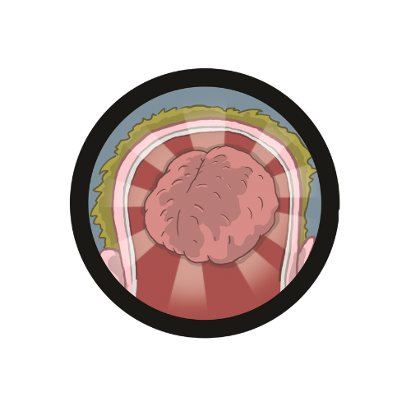
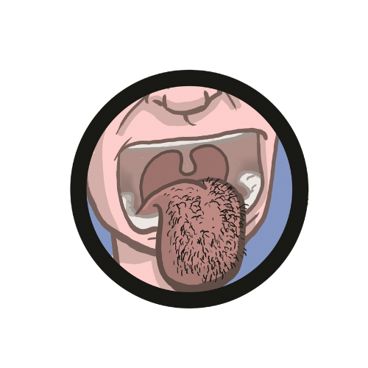
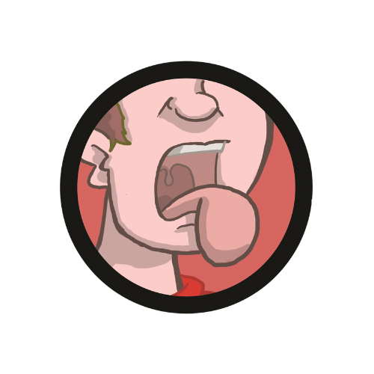
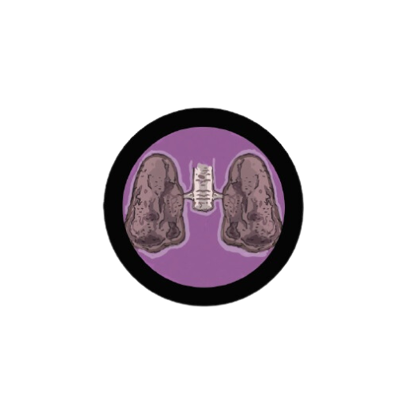
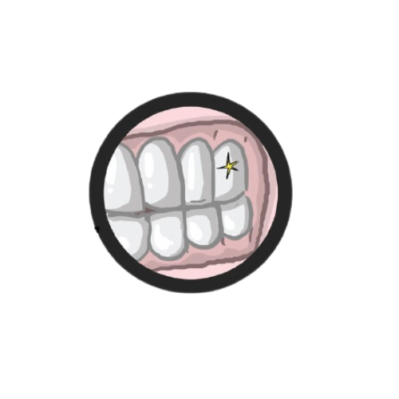
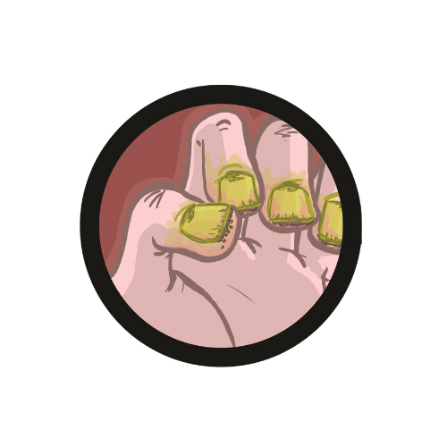
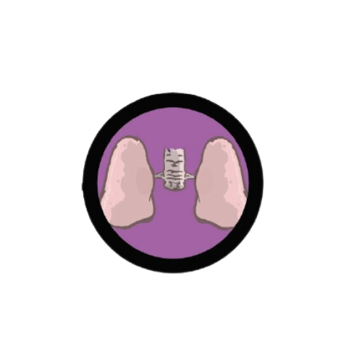
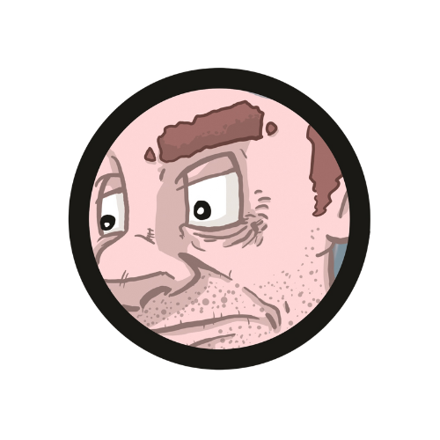
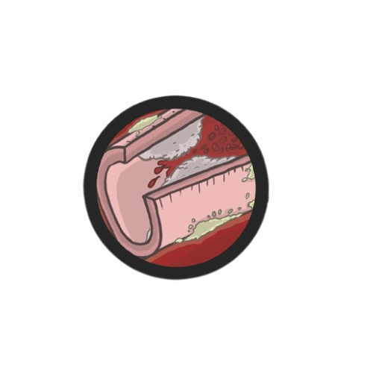
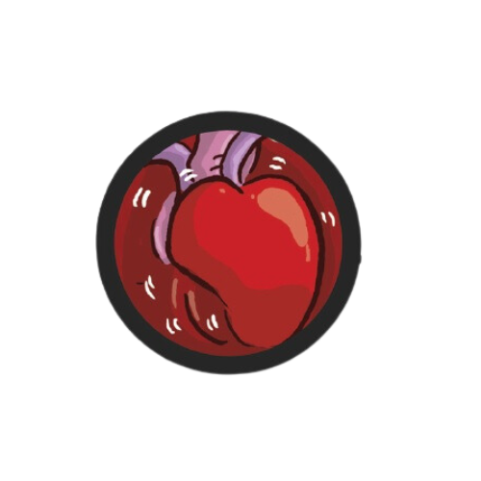
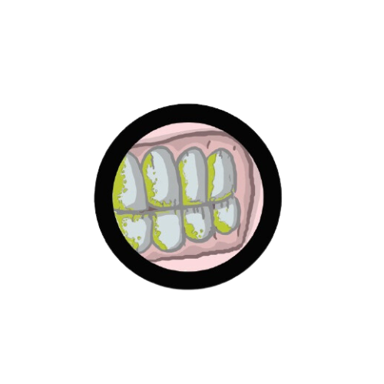
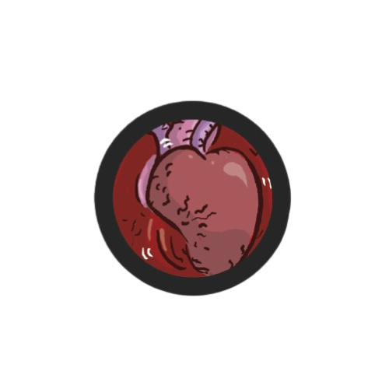

Slide 28
Nicotine Withdrawal
Nicotine is out of your body a few days after you quit smoking or vaping. Nicotine withdrawal symptoms peak 2 to 3 days after you quit, and are gone within 1 to 3 months.
Cravings for nicotine usually only last around 5-15 minutes. So, try to find something to distract you during this time.
The physical symptoms:
sweating
headaches
restlessness
tremors
difficulty sleeping
waking at night
increased appetite
abdominal cramps
digestive issues, including constipation
The psychological symptoms :
a strong craving for nicotine
irritability or frustration
low mood
difficulty concentrating
anxiety
mood swings
food cravings

Slide 29
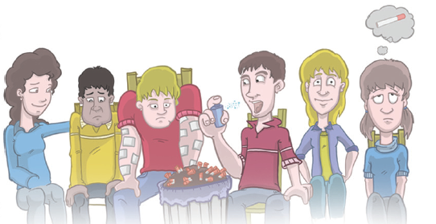
NRT is a medication that provides you with a low level of nicotine, without the tar, carbon monoxide and other poisonous chemicals present in tobacco smoke.
Most of these products are available FOR FREE on the NHS and to access them you just have to speak to a GP, Pharmacist or someone from Quit Your Way Scotland.
NRT is not prescribed to people under the age of 12, and it is not currently given to vapers.

